Slide 1
AC Signal
Dr. Michael Nasief

Slide 4
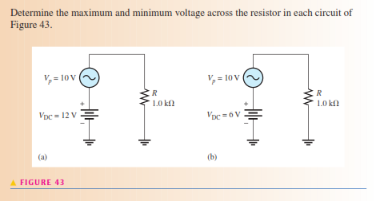
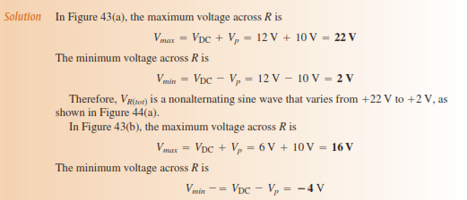

Slide 5
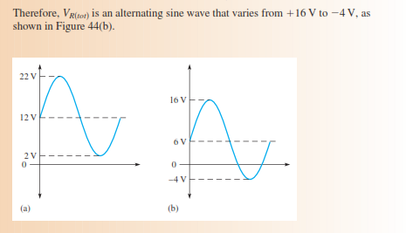

Slide 10
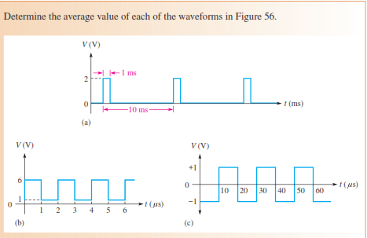

Slide 11
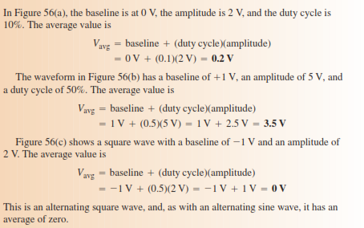

Slide 13
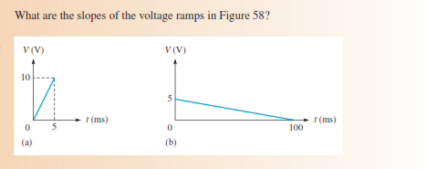

Slide 16
ANALYSIS OF AC CIRCUITS

Slide 17
Ohms law

Slide 18
Kirchhoff’s voltage

Slide 19
Power in resistive ac circuits

Slide 20
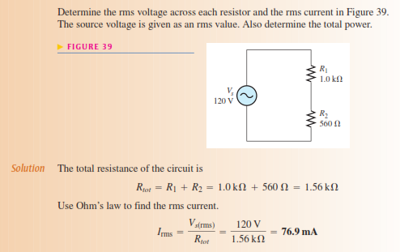
EXample

Slide 22
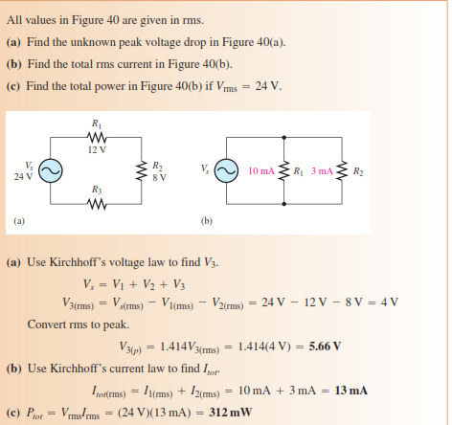
example

